Slide 1

Campus Climate Survey Validation Study (CCSVS)
Presented by BJS and OVW

Slide 2
CCSVS Background
Purpose: Develop and test a survey instrument and methodology for collecting valid and reliable data on sexual harassment, sexual assault, and campus climate
9 schools agreed to participate
  Variation in terms of size, public vs. private status, 2- vs. 4-year status, and geography
Survey administered to undergraduate males and females at the 9 schools
  Following the survey, respondents were provided with a list of support resources customized to each school
  ~15% checked out these resources

Slide 3
CCSVS Research Goals and Methodology
  Develop a valid and reliable instrument to collect data about sexual victimization experiences and the campus climate related to sexual victimization.
  Approach
  Used the WH Task Force Toolkit as a starting point
  Held listening sessions with stakeholders
  Conducted cognitive testing to understand how well questions work and are understood by students
  Included items to enable validity checks and latent class analysis

Slide 4
CCSVS Research Goals and Methodology - Instrument
Final CCSVS Instrument: “College Experiences Survey (CES)”
Brief (~15 minutes), confidential, self-administered web survey
Behaviorally-specific, 2-stage approach
Asked about sexual harassment and coercion prior to asking about sexual assault
Multiple reference periods
  “since the beginning of the current (2014-2015) academic year” (focus of most estimates)
  “since entering college”
  “lifetime”
Incident-specific follow-up questions (up to 3 incidents)
Broad array of campus climate measures

Slide 5
CCSVS Research Goals and Methodology
  Design and implement a data collection methodology that administers survey to a sample of students, achieves response rate and survey completion targets, and avoids nonresponse bias.
  Approach
Administered between Spring break and start of finals
Field period lasted ~57 days
Use of incentives ($25 for most respondents)
Survey could be taken on a range of devices
About 23,000 respondents (15,000 females; 8,000 males)

Slide 6
CCSVS Research Goals and Methodology – High Data Quality
Response rates higher than anticipated – (54% for females; 45% for males)
Nonresponse bias analysis suggested that nonresponders were not significantly different from those who responded

Slide 7
CCSVS Research Goals and Methodology
  Generate school-specific estimates of victimization and have the ability to compare findings across schools.
  Approach
Used a standardized instrument and methodology across all 9 schools
Weighting used to produce school-specific estimates
Schools are not identified by name
Standard errors and confidence intervals used to show significant differences

Slide 8
Sexual Victimization Estimates
P2. How many separate incidents of unwanted sexual contact have you experienced since the beginning of the current academic year in [FILL: August/September], 2014?
  0 incidents [IF P2 = 0 IINCIDENTS, SKIP TO LCA2]
  1 incident
  2 incidents
  3 incidents
  4 incidents
  5 or more incidents
1 or more incidents of unwanted sexual contact since the beginning of the 2014-2015 academic =victim of completed sexual assault
For each incident, a follow-up question is used to determine the type of sexual contact
  Incidents that included oral sex, anal sex, sexual intercourse (females only), or sexual penetration with a finger or object are classified as completed incidents of rape
  Incidents that included forced touching, but did not include penetration, are classified as completed incidents of sexual battery (excluding rape)

Slide 9
Sexual Assault, Rape, and Sexual Battery: Measurement
This section asks about times when you may have experienced unwanted sexual contact. In these questions, unwanted sexual contact is sexual contact that you did not consent to and that you did not want to happen. Remember that sexual contact includes touching of your sexual body parts, oral sex, anal sex, sexual intercourse, and penetration of your [IF D3 NE MALE, FILL “vagina or”] anus with a finger or object.
Please check off each point as you read through these descriptions. Unwanted sexual contact could happen when:
someone touches or grabs your sexual body parts (e.g., butt, crotch, or breasts);
someone uses force against you, such as holding you down with his or her body weight, pinning your arms, hitting or kicking you;
someone threatens to hurt you or someone close to you; or
you are unable to provide consent because you are incapacitated, passed out, unconscious, blacked out, or asleep. This could happen after you voluntarily used alcohol or drugs, or after you were given a drug without your knowledge or consent.
Please keep in mind that anyone – regardless of gender – can experience unwanted sexual contact. Also, the person who does this could be a stranger or someone you know, such as a friend, family member, or person you were dating or hanging out with.

Slide 10
CCSVS Prevalence Rates for Females - 2014-2015 Academic Year
Rape and sexual battery shown as mutually exclusive categories; sexual assault includes both

Slide 11
CCSVS Prevalence Rates for Females – Since Entering College and Lifetime
Includes respondents in all grades; not broken out by type of sexual assault

Slide 12
Sexual Assault Prevalence by Victim Characteristics
Data also collected on age, race/Hispanic origin, gender identity, year of study; lack of precision for disaggregating non-heterosexual estimates

Slide 13
CCSVS Incident-level data – Month of sexual assault incident (females)
Higher rates in Sept and Oct, especially for 1st year students; lower rates in April/May are due in part to the timing of data collection

Slide 14
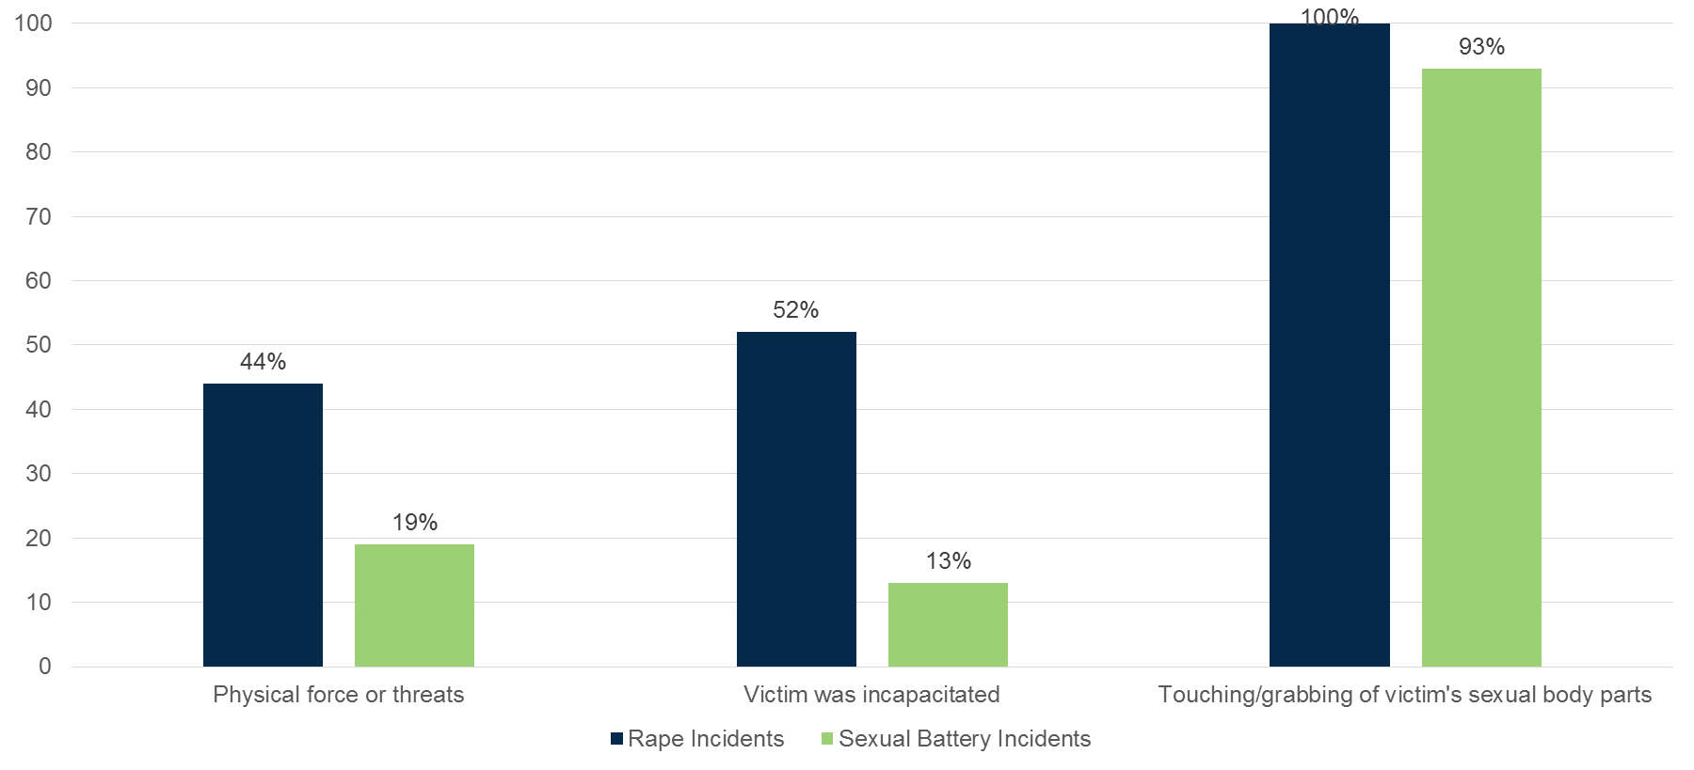
CCSVS Incident-level data - Tactic used by offender (female victims)

Slide 15
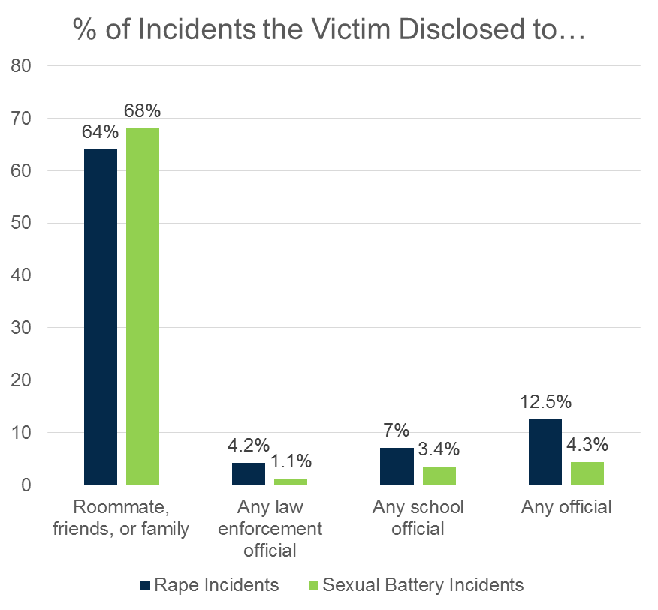
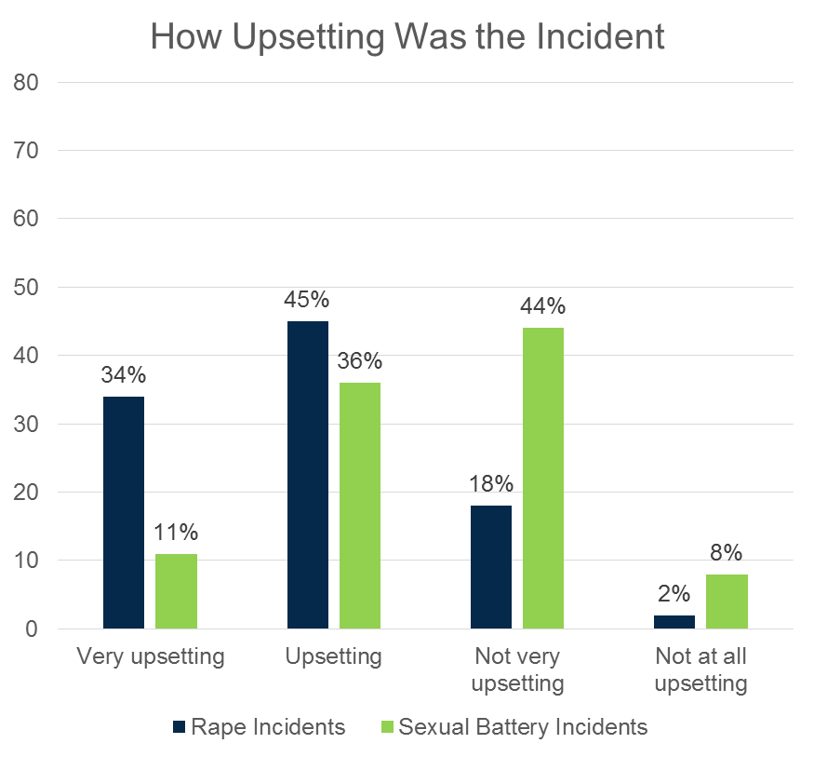
CCSVS Incident-level data - Victim disclosure and impact (female victims)

Slide 16
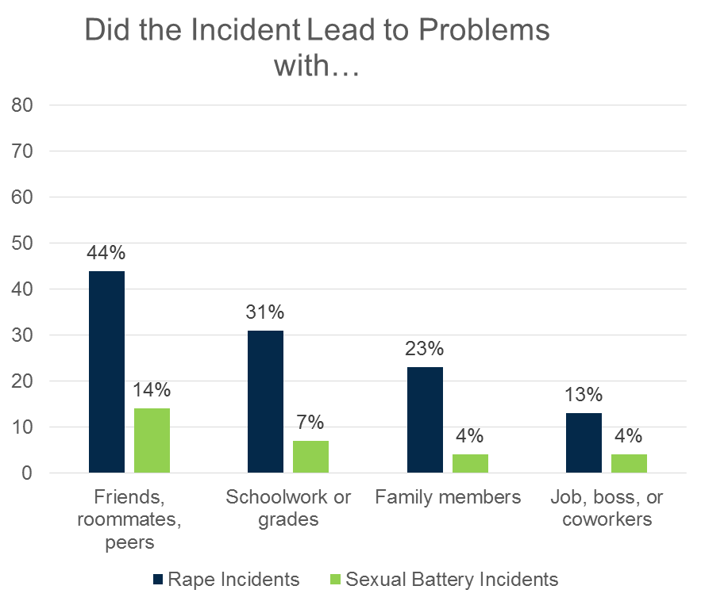
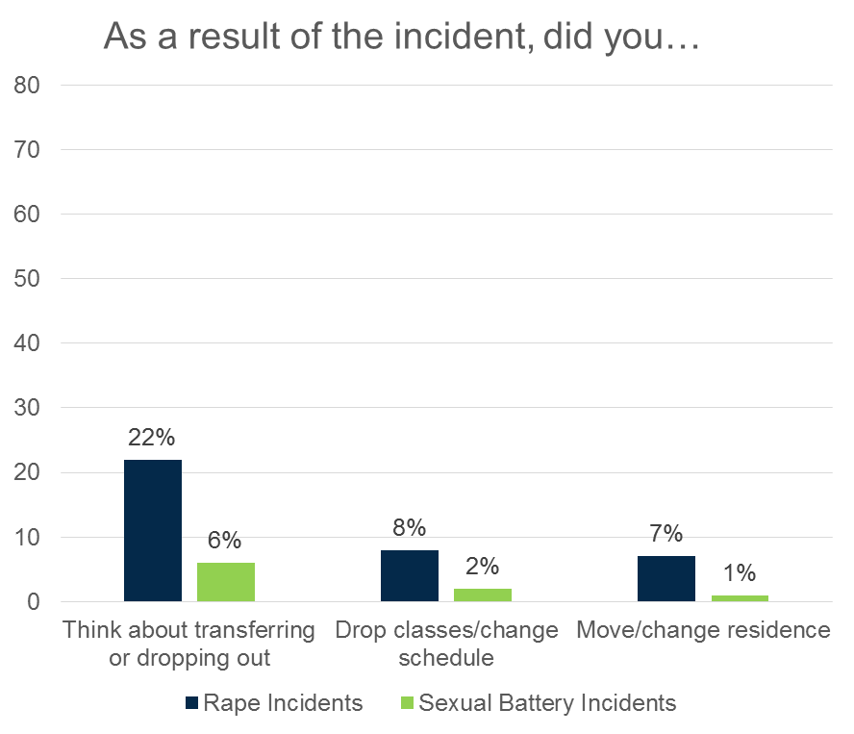
CCSVS Incident-level data - Victim impact (continued)
Source: Campus Climate Survey Validation Study (CCSVS), 2015.

Slide 17
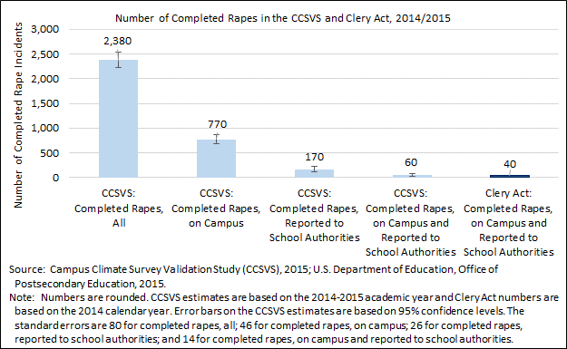
CCSVS Incident-level data - Comparison of CCSVS and Clery Data

Slide 18
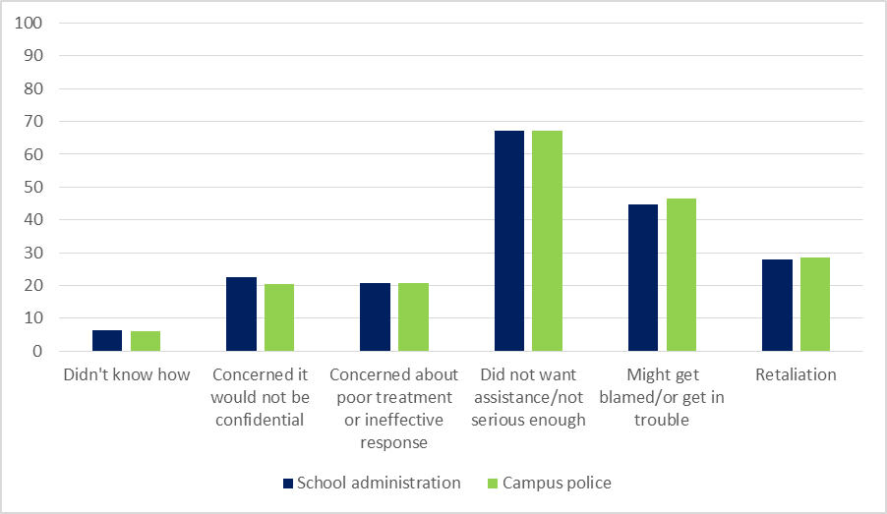
CCSVS Incident-level data - Reasons for not reporting rape incidents (females)

Slide 19
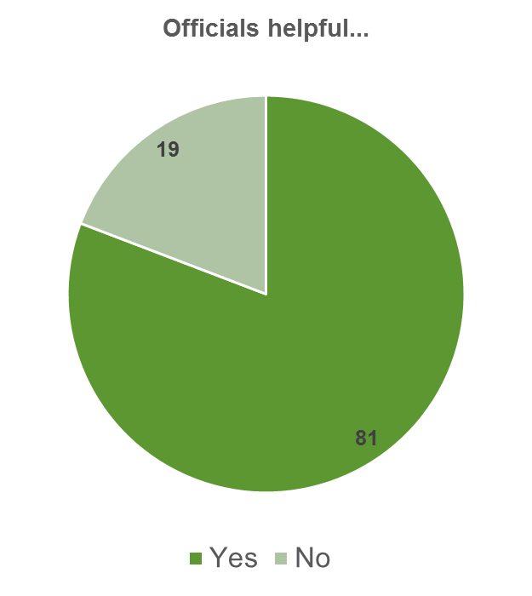
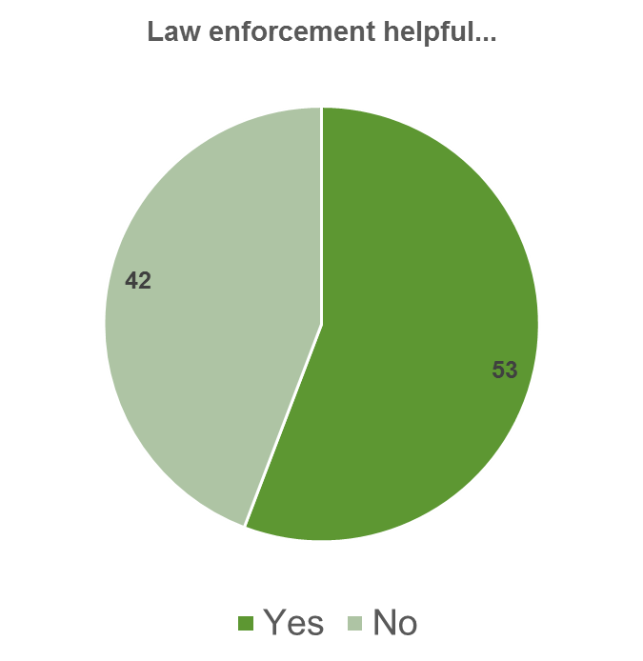
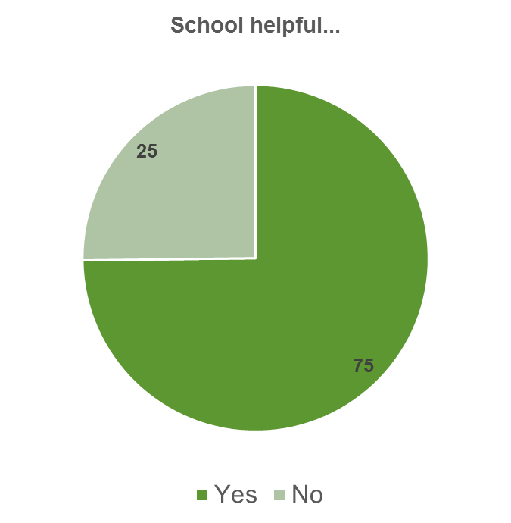
CCSVS Incident-level data – Satisfaction with reporting rape incidents (females), across all schools % relatively high, however, lots of variation across schools and depends on the % reported.

Slide 20
Campus Climate Measures and Association with Victimization
# | Label
1 | General School Connectedness
2 | General Perceptions of Campus Police
3 | General Perceptions of Faculty
4 | General Perceptions of Leadership Staff
5 | Perceptions of School Leadership Climate for Sexual Misconduct Prevention and Response
6 | Awareness and Perceived Fairness of School Sexual Assault Policy and Resources
7 | Perceptions of School Leadership Climate for Treatment of Sexual Assault Victims
8 | Likelihood of Personal Bystander Behavior to Prevent Sexual Misconduct
9 | Perceptions of Student Norms Related to Sexual Misconduct: Student Misconduct
10 | Perceptions of Student Norms Related to Sexual Misconduct: Student Bystander Behavior and Involvement
11 | Personal Acceptance of Sexual Misconduct

Slide 21
Sexual harassment and coercion (females)

Slide 22
CCSVS Prevalence of Intimate Partner Violence (females)

Slide 23
For More Information about the CCSVS
Mike Planty, PhD
Bureau of Justice Statistics (BJS)
202-514-9746
michael.planty@usdoj.gov
For policy-related issues, email Allison Randall at OVW – allison.randall@usdoj.gov
For the full report and additional resources:
www.bjs.gov/content/pub/pdf/ccsvsftr.pdf
http://changingourcampus.org/resources/research

