Slide 1


Slide 2

Ice Breaker
Options: Writing or Interview
Prompt Questions:
  What activities are you doing when you are at your best?
  Write/talk about the most important person in the world to you.

Slide 3
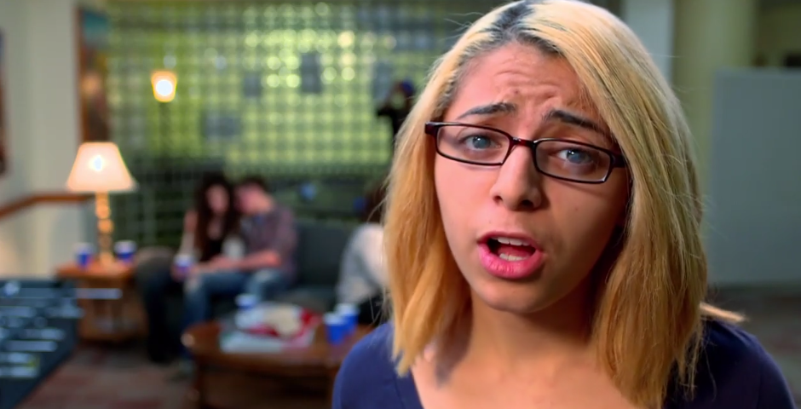
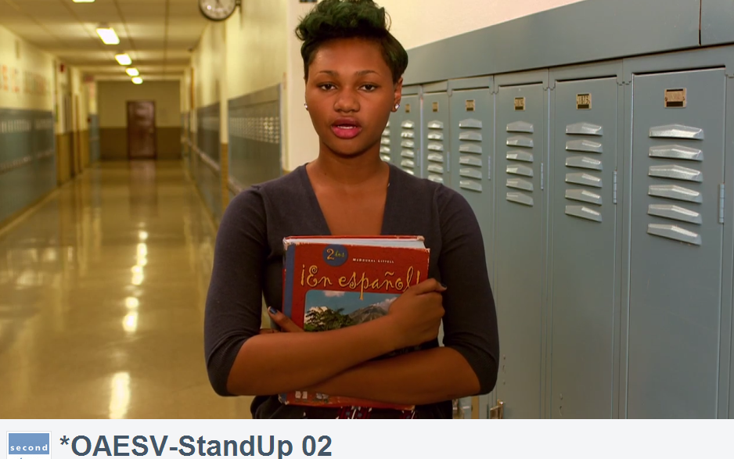
Stand Up
Watch the Video…
  https://vimeo.com/78294857
  password: OAESV

Slide 4
Stand Up Video
Take a moment and write down your first impressions

Slide 5

Discussion
    What is a bystander?
Written only (just for you):
  Have you ever experienced or witnessed situations similar to the one depicted in the video?

Slide 6
Discussion
    When thinking about that situation, what about it made you know that this situation required a bystander action —what made you have a gut reaction?

Slide 7
Discussion
    If it were easy, people would intervene all the time.
    But we know that people have a lot of barriers that get in the way of them intervening, even when they think they should.
    What barriers might you face taking a bystander action in this or any situation?

Slide 8
Ways to get involved
There are 3 ways to be an active bystander:
  Do something yourself
  Get someone else to help
  Be a distraction

Slide 9
Discussion
Which of the solutions outlined in the video would work for you in this situation?
Would you take those actions if it was your friend you had to confront?

Slide 10
Upstander
An upstander is someone who intervenes in situations that make them uncomfortable, using any of the ways available to them (not just directly confronting someone).

Slide 11
Role Plays
Now as a class come up with similar situations where you might want to intervene, but want to practice.
Break into small groups
Practice three different intervention options: doing something yourself, getting someone to help, or being a distraction.

Slide 12
Wrap Up
Contact OAESV with questions or connect with your local rape crisis center!
www.oaesv.org
216-658-1381
info@oaesv.org

