Slide 1

The Importance of
Organizational Accessibility
Liz Poprocki, MA, RA, CA – Equitology Consulting

Slide 2

Being proactive is equity in action
Decrease re-traumatization
Be inclusive
Build equitable access to build resiliency
Everyone deserves to heal

Slide 3
REFLECTIONS
Ableism perpetuates oppression and violence against persons with disabilities
Ableism limits services
Ableism affects our worldview
Accessibility is achievable

Slide 4
WHAT IS NEEDED
TO BE ACCESSIBLE?
Top-down organizational belief
Leadership and staff want to learn
Adopting inclusive core values
Staff hold one another accountable
Understanding the impacts of ableism
Knowledge of disability and intimate partner violence
Notes:
Not so sure your organization has all that it needs? That’s okay. Our time together today is meant to help you get to where you need to be to fully adopt accessibility that is appropriate for your organization. In the second module you saw all the different ways services can be made accessible however those services can’t be made accessible if the organization itself has not adopted accessibility and believes that it is necessary for survivors to recover. During our time together, we are going to discuss internal accessibility, how to conduct an accessibility evaluation of your organization, how to develop an inclusivity plan, internal policies and procedures to consider when implementing your inclusivity plan, and how to build collaborative relationships with disability service programs.
Top-down organizational belief
Organization and its leadership want to learn about accessibility
Inclusivity, accessibility, and equity are core values of the organization
Staff hold one another accountable
Respect for self-determination, self-identification, autonomy, disclosure
True understanding of disability and intimate partner violence

Slide 5

INTERNAL ACCESSIBILITY

Slide 6

INTERNAL ACCESSIBILITY
Leadership & governance
Values
Accountability
Accessible policies for employees
Ongoing education

Slide 7
LEADERSHIP & GOVERNANCE
BOARD CONSIDERATIONS
LEADERSHIP CONSIDERATIONS
Diversify the Board
Written commitment
Strategic planning
Consult with ADA expert
Educational opportunities
Core values
Accessibility evaluation
Commitment to inclusion
Hiring practices
Development of policies and procedures
Implementation
Designate an ADA contact
Notes:
People with disabilities often serve as board members for disability-focused organizations but rarely do they serve as board members of non-disability focused organizations. Many organizations and their boards do not understand the intrinsic values of including disabled persons on the board let alone as organizational leadership, staff, and survivors.
Here we have a few ways that leadership and their Boards can begin adopting that top-down approach to making an organization more accessible. These are in no particular order. To begin, Boards can conduct a self-evaluation that includes gathering information about their attitudes regarding board diversity. Such an evaluation can uncover the Board’s attitudes and beliefs around diversity (disability, race, gender, etc.) and give the board a clear understanding of what they would like to see in its members and overall representation. From this, the board can then make changes to its recruitment strategies.
The board can write and sign a commitment to inclusivity and diversity as it pertains to persons with disabilities. Many organizations are currently evaluating their diversity and inclusion practices involving race and gender. A true inclusivity evaluation should be intersectional and include disability among many others. These commitments to the organization set a precedence, provide support to its leadership, and set expectations for service delivery. These written commitments then lead to strategic planning. Strategic planning can include the steps needed to ensure accessibility for the program or simply for the board to start off. Inclusive strategic planning is a way to hold both the governing body and leadership accountable. Strategic planning may uncover some large goals that the organization will undertake towards accessibility. Accessibility outside of programs can be tricky especially when they are all about physical accessibility. Maybe the board can consult with an ADA attorney for reviewing internal policies and procedures for their accessibility both for staff and employees. They may also want to consult with an ADA architect/engineer focused on physical accessibility or an IT company/professional who can assist with technological accessibility.
And last but certainly not least, make space for educational opportunities for Board members when it comes to disability and accessibility. For your Board members to be on the same page and dedicated to the strategic plan and internal efforts towards accessibility, education is the way to go. This could be done with speakers at board meetings or retreats, recommendations for books and articles focused on the program’s current goals, and regular updates from leadership on the program’s progress towards accessibility.
Now that we have the board on board – it’s time for leadership. In an ideal world, the board would have their responsibilities while leadership will have theirs. Focused on the everyday workings of the program, leadership may want to conduct an evaluation of the organization’s accessibility both for staff and clients. It’s important here to conduct the evaluation prior to anything else on this list as it is the guidance for all other changes. These internal and external evaluations will provide leadership with invaluable knowledge of how their internal policies and procedures can be improved to accommodate staff who may have disabilities and assist in the development of policies or revision of current policies to promote accessibility for survivors. From this evaluation, leadership will make a commitment to improving its accessibility both for staff and survivors. This commitment should be written, discussed at leadership meetings, and placed as a priority for the organization. After leadership has made this commitment, they can utilize the evaluation to revise their hiring procedures and/or make the organization more accessible to hiring persons with disabilities ensuring that the program is not discriminating against job candidates or employees. Based on the evaluation results they may also develop policies and procedures that meet the needs of both staff and survivors and oversee the implementation of these policies and procedures.

Slide 8

VALUES
Inclusivity
Equity
Disclosure
Confidentiality
Self-determination
Self-identification
Autonomy
Notes:
As we know from the last two modules, ableism deeply affects an organization’s ability to fully serve survivors with disabilities. It is pervasive in our systems. Therefore, when making commitments to become more inclusive and accessible, organizations should consider adopting these values focused on disability. Adopting these values and integrating them within your organization will ensure that survivors with disabilities receive quality services. These values are VITAL and FOUNDATIONAL to accessible services and an accessible work environment.
Inclusivity – As we discussed in the first module, many rape crisis programs are not inclusive or outwardly inclusive of disabled survivors. They are declined services, provided inadequate services, or referred to another organization who may or may not be able to meet their needs.
Equity – Refer to the picture
Disclosure – In order for employees and survivors to receive services and accommodations that will pave a successful path towards employment or resiliency, they must be able to determine if the environment is safe to disclose their disability. Many survivors and employees go without accommodations because of the fear of stigmatization, denial of services/employment, having their disability used against them, not being seen as credible, etc. All of the reasons for non-reporting that we discussed in the first module.
Confidentiality – With disclosure must come confidentiality.
The next three are specific to disabilities, especially survivors of sexual violence with disabilities. As we are aware, victimization leaves survivors feeling a lack of control, abandoned, lost, confused, and not able to make their own decisions. These are trauma responses. Disabled persons, because of ableism, are often viewed as not being able to care for themselves, make their own decisions, have self-awareness, be able to identify as anything other than disabled, and live independently in their communities. These judgments, while completely false, dictate how services are delivered and dictate the survivor’s place in our society.
In order to TRULY serve survivors with disabilities, we must adhere to the disability rights model that asserts that persons with disabilities know what is best for them, can make their own decisions, can identify however they choose, and can live independently within our communities. This model seeks disabled survivors as they are – as PEOPLE – and no less.
These values are in direct contradiction from ableist beliefs and adopting them is an active attack against systemic ableism and oppression.

Slide 9

Accountability promotes:
  Transparency
  Improvement
  Responsibility
  Commitment to values and goals

Slide 10
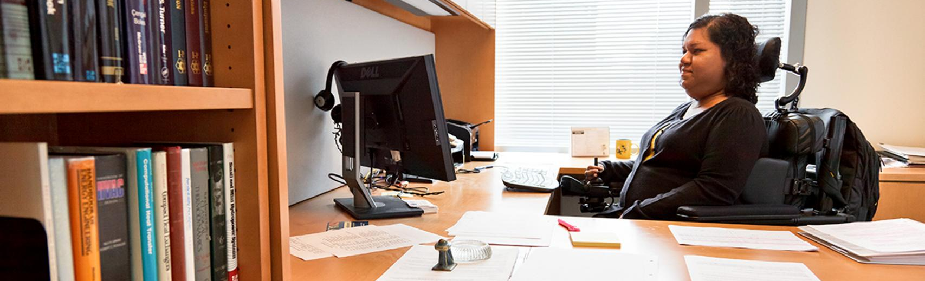
EMPLOYEE ACCESSIBILITY
Benefits
  Retention
  Trauma-responsive
  Representation
  Employee satisfaction
  Successful services
National Conference of State Legislators
  https://www.ncsl.org/research/labor-and-employment/disability-101-employment-policies-and-etiquette.aspx

Slide 11

ONGOING EDUCATION
Disability Visibility Project
ADA National Network
California Coalition Against Sexual Assault (CALCASA)
NPR – Abused and Betrayed
VERA Institute
National Center for Reaching Victims
Notes:
These are just the beginning but there are TONS of resources out there

Slide 12

ACCESSIBILITY EVALUATION

Slide 13
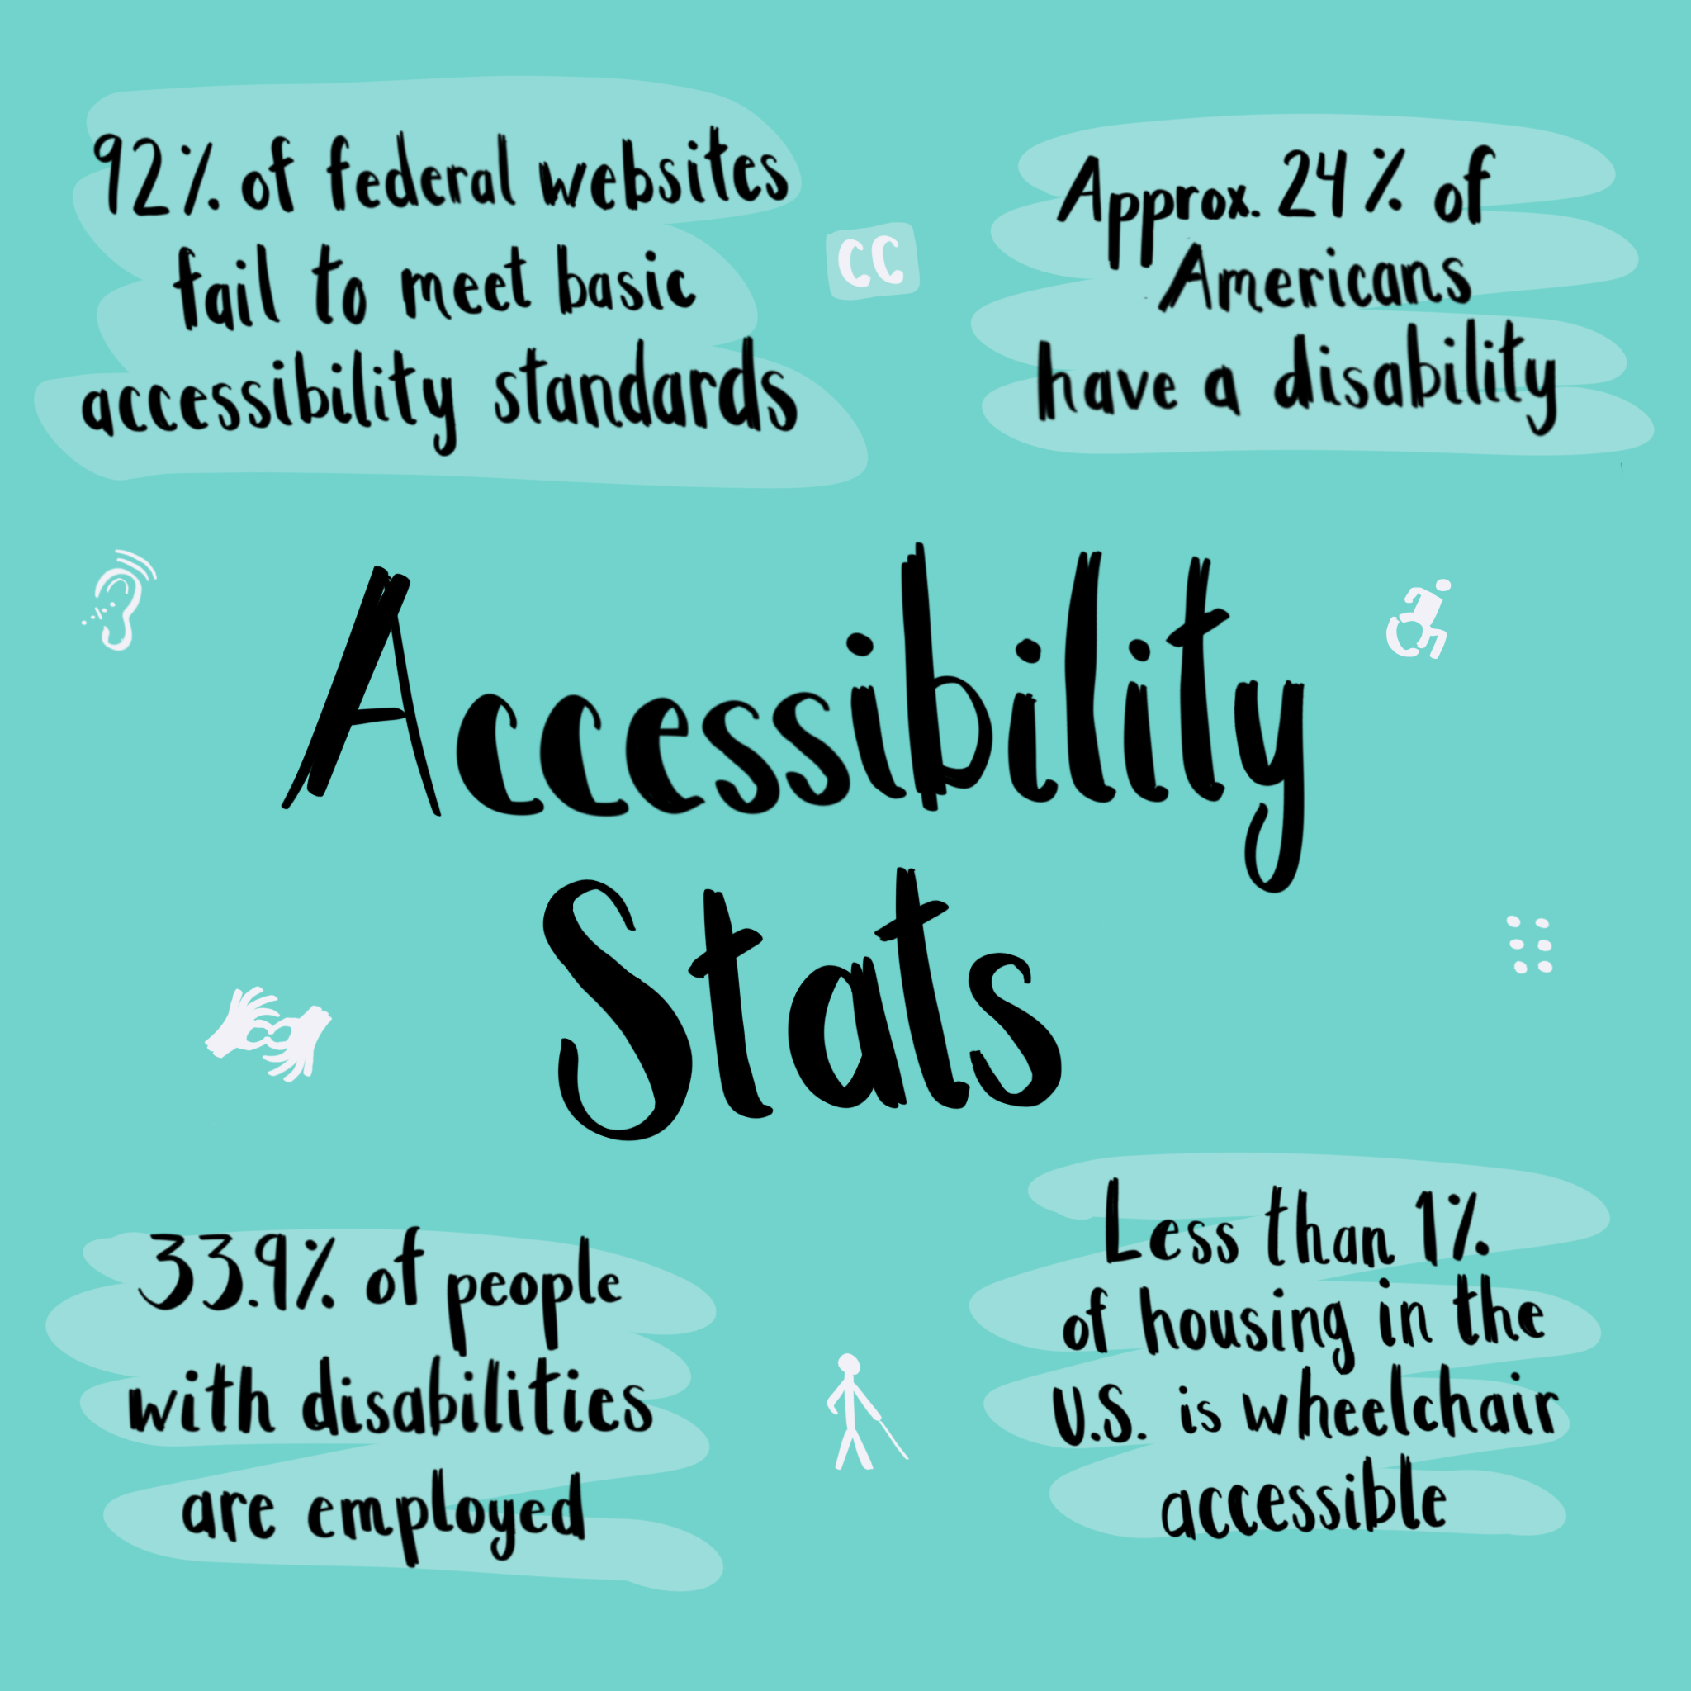
WHAT DO YOU WANT TO KNOW?
Physical accessibility of the building
Attitudes of staff towards persons with disabilities
Services that need to be offered
Services that need to be made accessible

Slide 14

HOW DO YOU CONDUCT AN EVALUATION?
Contact your county’s engineer for recommendations
Contact the ADA National Network (Ohio is Region 5)
  http://www.adagreatlakes.org/
Hire a consultant to assess attitudinal and programmatic accessibility
Hold forums with staff, survivors, and persons with disabilities
Have discussions with collaborative partners
Conduct an evaluation of website/technology accessibility

Slide 15

INCLUSIVITY PLAN

Slide 16

INCLUSIVITY PLAN EXAMPLE
Financial/Funding
Physical/Attitudinal
Employment
Programmatic
Communication
Technology
Outreach
Leadership and staff education

Slide 17

FUNDING
Undue Burden
Grants for short-term projects
  Website accessibility
  Tech accessibility
  Hire consultant to review policies and procedures
  Ramps and other physical accessibility

Slide 18

PHYSICAL & ATTITUDINAL
What was identified as physical barriers?
  Are these physical barriers able to be fixed?
  Can we find funding to fix them?
  How much would these fixes cost?
  Prioritize according to needs
What was identified as attitudinal barriers?
  What is needed to overcome these barriers?
  Policies and procedures to hold staff accountable

Slide 19

EMPLOYMENT
Improving hiring practices for diversity
Accessibility for volunteers
Integrating accessibility within case consults with staff
Universal design of office environment
Identifying educated staff as ADA contact
Read research conducted on disability and employment
Know your responsibilities under the ADA

Slide 20
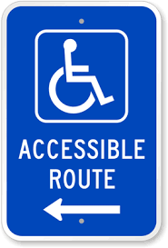
PROGRAMMATIC
Program information in an accessible format
Considering universal design in how survivors can contact you
Develop process for responding to requests for accommodations
Establish a list of ASL interpreters
Integrate recommendations from “Supporting Survivors of Sexual Assault with Disabilities”

Slide 21

TECHNOLOGY
Assess website accessibility for screen readers
Include alt-text on all images on social media and on website
Do staff have technology that allows them to be accessible to survivors with disabilities?
Assess internal technology for accessibility
If funding obtained, conduct assessments on technology
https://webaim.org/

Slide 22

OUTREACH
Building relationships with disability service providers and
self-advocates
Educate the community
Having publications in accessible formats
Holding accessible outreach events in accessible venues
  Closed Captioning
  Interpreters
  Physical accessibility
Integrating recommendations from “Supporting Survivors of Sexual Assault with Disabilities”

Slide 23

LEADERSHIP AND STAFF EDUCATION
Annual completion of training re: survivors with disabilities
Integrate education of survivors with disabilities into staff and volunteer onboarding practices
Hire self-advocates to present to staff
Cross-trainings with disability service providers

Slide 24
IDENTIFYING SOLUTIONS
Consider resources, time, and partnerships to address each need
Consider the urgency of unmet needs
Analyze which resources you already have to address each issue
What are your short-term goals?
What are your long-term goals?
BE REALISTIC!

Slide 25
POLICIES AND PROCEDURES

Slide 26
POLICIES TO CONSIDER
Service/Emotional Support/Companion Animals
Procedure for accessibility grievances
Teleadvocacy
Conducting advocacy in alternate locations
Inclusion of “accessibility” in policies and procedures
Using email and/or social media to communicate with survivors
Accessibility statement
Non-discrimination statement (mostly required by grants)

Slide 27

COLLABORATIVE CARE WITH EXTERNAL PARTNERS

Slide 28

INTENTIONAL COLLABORATION
County Boards of DD
County ADAMHS Boards
Local agencies that serve Deaf and/or Blind citizens
Ohio Department of Developmental Disabilities
Ohio Department of Mental Health and Addiction Services
Adult Advocacy Centers
Persons with disabilities (self-advocates)
Family of persons with disabilities
In-home service providers

Slide 29

Identify key partners
Hold meetings with key partners
Discuss key partners’ reasons for participating and how they can contribute
Share vision: To improve the lives of survivors with disabilities.
Discuss roles and expectations
Work towards the shared vision
Cross-training between providers
Develop MOUs

Slide 30

Who is your target audience?
Start small with pilot program or single partnership
Staffing booths at events
Distributing program information to community partners
Advertising your services
Open houses
What do YOU want the community to know?
The organization must be internally accessible before they can promote accessible programs externally

Slide 31
FUNDING RESOURCES
The Disabled Access Credit or other credits under the IRS
  Check with your accountant and/or attorney for your eligibility
Grantwatch.com
Local and statewide foundations and philanthropies focused on improving access for disabled persons
Americans with Disabilities Act National Network funding
Administration for Community Living
Dept. of Justice, Office for Victims of Crime Discretionary Grants
The Disability Foundation

Slide 32
RESOURCES
ADA National Network - https://adata.org/
ADA National Network Regional Office - https://adata.org/find-your-region#region5
ADA Checklist for Existing Buildings - https://www.adachecklist.org/doc/fullchecklist/ada-checklist.pdf
United States Access Board - https://www.access-board.gov/
Americans with Disabilities Act - https://www.ada.gov/

Slide 33
STATE RESOURCES
Adult Advocacy Centers
Disability Rights Ohio
OVWA – “Serving Survivors with Disabilities”
Ohio Department of Mental Health and Addiction Services
Ohio Department of Developmental Disabilities

Slide 34
CONTACT INFORMATION
Liz Poprocki, MA, RA, CA
Equitology Consulting, LLC
equitologyconsulting@gmail.com

