Slide 1
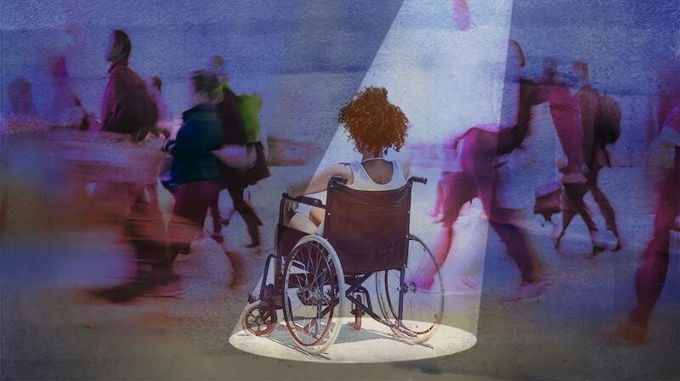
Supporting Survivors of Sexual Assault with Disabilities
Liz Poprocki, MA, RAAS, CA
Equitology Consulting, LLC

Slide 2
Goals of our time together
DEFINE
Define disability under the Americans with Disabilities Act
ADD
Add onto knowledge obtained from first module
LEARN
Learn how to provide equitable accommodations and services to survivors with disabilities
APPLY
Apply knowledge from first and second module to better serve survivors with disabilities in an anti-oppressive and equitable way

Slide 3
reflections
Sexual assault against persons with disabilities is an epidemic
We are missing comprehensive data on just how big an epidemic this really is
We know that ableist systems have and continue to place barriers to resiliency for survivors with disabilities
We know that ableism is at the core of sexual assault against persons with disabilities
There is a lack of anti-oppressive, anti-ableist, intersectional and equitable services for survivors with disabilities
Inaccessible and ableist systems do not allow for transparency, reporting, healing and justice

Slide 4
WHO IS THIS INFORMATION FOR?
Hotline/Crisis Advocates
Emergency Room Advocates
Aftercare Advocates
Prevention Programs
Legal/Law Enforcement Accompaniment
Campus Advocacy
Organizational Leadership
Volunteers

Slide 5
Guidelines for learning
The information provided today is an expansion of the Core Standards
The information is in alignment with the Core Standards for easier application

Slide 6
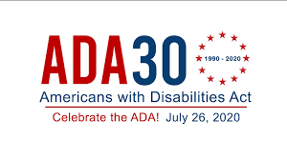
What is the ada?
Signed into law on July 26th, 1990 by President George H.W. Bush
Modeled after the Civil Rights Act of 1964 and Section 504 of the Rehabilitation Act of 1973
One of our most comprehensive pieces of civil rights legislation
“Prohibits discrimination and guarantees that people with disabilities have the same opportunities as everyone else to participate in the mainstream American life – to enjoy employment opportunities, to purchase goods and services, and to participate in State and local government programs and services.” – www.ada.gov

Slide 7
What is “disability”?
A physical or mental impairment that substantially limits one or more major life activities, a person who has a record of such an impairment, or a person who is perceived by others as having such an impairment.
Notes:
This vague definition is a benefit, not a problem.
A survivor can be considered disabled under the ADA even if they don’t specifically identify themselves as being “disabled”.
A survivor’s precise diagnosis is less important than their need for accommodations (perceived by others)
This vague definition allows for flexibility and avoids disability models of structure
The ADA does not specifically name all of the impairments that are covered.
The ADA definition undercuts the divisive hierarchies that have been designed within and outside of the disability community.
The ADA applies to significant impairments. Minor impairments (like nearsightedness) don’t apply. What also doesn’t apply are simple things you’re just not that good at.
Perceived Impairment – People who aren’t actually disabled can be materially harmed by disability discrimination. Therefore, non-disabled people can also be protected under the ADA through the language of “perceived impairment”. Examples might include the non-disabled spouse or family of a disabled person, people with a visible condition like facial disfigurement that doesn’t necessarily impair you but it does inspire disability prejudice, and people who once had a long-term/chronic condition but don’t anymore like cancer.

Slide 8

Why is this information important to you?

Slide 9
Title Iii Regulations
Implements the ADA for businesses and non-profit service providers
Physical and programmatic accessibility
Open to the public
Privately owned facilities
Office buildings
Non-residential facilities (schools, doctors’ offices, day cares, etc.)
Rape Crisis Centers

Slide 10
General prohibitions
Denying a qualified individual with a disability the opportunity to participate or benefit from services
Providing unequal, different, or separate services to a disabled qualified individual
Perpetuating discrimination against disabled persons
Denying disabled people the opportunity to participate on boards
Limiting a disabled individual’s rights
Cannot “screen out” disabled individuals
Cannot make a disabled individual pay for program accessibility accommodations
Notes:
DENYING – Not allowing a person access to your services because they have a disability. Refusing to serve them because they have a disability. Claiming that you are unable to serve them because you don’t know how to because of their disability.
UNEQUAL SERVICES – Segregation is a big no-no. Providing services to disabled persons that are different, garner different results, are unequal in the goals and nature of the service just because that person has a disability. For example, only providing services over the phone to persons with disabilities and not in-person. Limiting a disabled person’s time with an advocate but not limiting the time for an abled survivor. Let’s be clear though that equal does not be equitable. Giving a brochure to a blind person just because “that’s what you do for everyone” would be considered providing inequitable services that are not in alignment with the ADA.
DISCRIMINATION – Continuing to not address ableist and attitudinal barriers within your organization. Only partnering with other organizations that support discrimination or refuse to serve persons with disabilities. This is a key component to ALL of our funding in the crime victim advocacy world – to not participate in discrimination. However, participating in discrimination can also be subtle. Participating in discrimination can also look like a refusal to provide equitable and accessible services; it can look like verbal support of this demographic but not confronting a co-worker who uses ableist language to describe a client; it can look like saying you have a disabled family member but then using ableist tactics and participating in discrimination because you think you can.
PARTICIPATION ON BOARDS – Refusing to allow people with disabilities (visible and hidden) to participate on your boards and planning committees because you are concerned about the optics or you have stereotyped those individuals and think that they cannot fully participate/comprehend their role and responsibilities. Boards and planning committees should be representative of those you serve. If you are not serving persons with disabilities or don’t know if you are or have, then that means that you most likely aren’t.
RIGHTS – Refusing to accept that disabled persons have some extra rights because of their protected status. Gaslighting a disabled person, not allowing them access to exercise their rights within your organization (speak with the ADA coordinator/rights coordinator), refusing to provide accommodations, not allowing their service animal or assistive technology within your organization/services.
“SCREEN OUT” – Making it so disabled persons (visible or invisible) cannot participate in your services. An example would be saying that a disabled person’s “level of care” is too high for your organization to take on therefore you cannot serve them at all. In the social work/counseling work, this would look like implementing restrictions on how many cancellations a person can have/late notices/no-shows/requiring payment for services/saying that if they cannot do such and such then their services will be limited/ refusing to provide any level of service because their mental health/disabilities. Another example would be refusing to provide services because your organization “cannot” provide accommodations.
PAYMENT – Going back to the last point of screening-out disabled individuals…organizations are required to provide reasonable accommodations to improve program accessibility. This may look like obtaining an interpreter, braille publications, producing audio publications, large print, closed captioning, physical accessibility, or even attitudinal accessibility through staff training. This prohibition means that organizations cannot make a disabled individual pay for such accommodations that they need. For example, if you are providing services to a Deaf individual, it is not their responsibility to pay for the interpreter/ If you are providing services to a Blind individual that uses Braille it is not their responsibility to obtain your publications and documents in Braille/ If a survivor cannot physically access your services, it is not their responsibility to pay for a ramp for your business/ If a survivor has a disability that staff have little knowledge of, it is not their responsibility to hire someone to educate your staff.

Slide 11
MORE GENERAL PROHIBITIONS
Shall make reasonable accommodations in policies, practices, or procedures when modifications are necessary to avoid discrimination on the basis of disability (unless undue hardship)
Shall provide services in the most integrated setting appropriate to the needs of disabled individuals
May impose safety requirements for safe operation of services IF ONLY those safety requirements are based on ACTUAL risks and NOT risks based on speculation, stereotypes, or generalizations of persons with disabilities
Notes:
REASONABLE ACCOMMODATIONS – (Types of Reasonable Accommodations: https://odr.dc.gov/book/manual-accommodating-employees-disabilities/types-reasonable-accommodation#:~:text=Needed%20accommodations%20may%20include%20providing,Sign%20language%20interpreters%20or%20captioning.)
Reasonable accommodations are adjustments made to systems to make the system fair for an individual with a proven need. Reasonable accommodations are rooted in equity as accommodations are made to meet each person’s unique needs. It is the disabled person’s responsibility to request reasonable accommodations HOWEVER, we are empathic people in this field and it’s also okay to offer brainstorming dialogue with the survivor to discuss how systems can be more effective for them. The goal here is recovery, not whether or not someone can fit within a box we have made for them. Some examples might look like – obtaining an interpreter, making accommodations to service policies when someone’s ability to participate in services is affected by their disability (medication, sleeping, eating, activities of daily living), use of telephone headsets, lowered desks for welcome desks, special software for computers, closed captioning, meeting people at an accessible location instead of in your office which might not be accessible, audio formats for documents, etc., large print. (Job Accommodation Network: https://askjan.org/a-to-z.cfm)
2) UNDUE HARDSHIP – Undue hardship means that the service provider would not be able to provide the accommodation because doing so would require significant difficulty or financial expense. To say that you cannot provide an accommodation due to “undue hardship” would include the total cost of the accommodation in relation to the size, resources, nature, and structure of the organization’s operation. Undue hardship is determined on a case by case basis. The organization must try and find another accommodation that would not impose such a hardship and offer this to the survivor.
3) INTEGRATED SETTING – An integrated setting is defined as a setting that allows disabled individuals to interact with abled persons to the fullest extent possible. Integrated settings provide disabled individuals opportunities to live, work, and receive services in their communities. A non-integrated setting would mean that you are providing services to disabled survivors in a separate location away from abled survivors.
4) SAFETY REQUIREMENTS – Imposing any safety restrictions to services would need to be directly related to that person’s disability and be imposed to keep that survivor safe. An example of a bad safety requirement would be requiring survivors who use wheelchairs to have a companion with them at all times to receive your services. Another bad example might be requiring persons with mental illness to only be seen in a room that is near the front desk “in the event of a crisis”. This assumes that persons with mental illness are dangerous and require supervision and a lack of privacy. It also immediately labels them as a person with a mental illness as everyone knows that the staff only see people with mental illness in that room. If safety restrictions are implemented, it is best to make them a general accommodation for all service recipients unless there is a need for a safety requirement for an individual survivor because your organization cannot provide that level of service to maintain that individual’s safety.

Slide 12
What is “accessibility”?
The design of products, devices, services or environments so as to be usable by persons with disabilities. (www.myblindspot.org)
Accessibility ensures both “direct access” and “indirect access”
Direct access is unassisted access
Indirect access means compatibility with a person’s assistive and adaptive technology
Notes:
There are several ways to define accessibility. It is a word that can be flexible and used in a variety of situations. However, today we will be defining the word as it relates to disability.

Slide 13
What accessibility is not!
Not to be confused with usability
Usability is the extent to which a product can be used by specified users to achieve goals of effectiveness, efficiency, and satisfaction in a specific context of use
Cell phones – making calls and texting

Slide 14

Universal design
Making things accessible to ALL PEOPLE whether they have a disability or not when the approach involves direct access (intake, reading your website)
An alternative is to provide indirect access by supporting the use of a person’s assistive technology so they can have access (website/publication compatibility with screen readers)
Notes:
EXAMPLE:
“A rape crisis centers’ intake is one of the first opportunities to welcome a survivor with disabilities. So it is essential to ask questions about disability or disability-related needs only after a person’s eligibility for services has been determined and communicated to the survivor. It is also essential that if any questions about disability related needs are to be asked – then the question(s) must be asked of ALL clients. This avoids the perception that a disability was used to determine eligibility or to screen someone out. The civil rights law is clear: a disability cannot be used to determine an abuse survivor’s eligibility for services. In addition, it is not appropriate to probe or ask for more details or seek additional information if a sexual assault survivor reveals a disability.” – This means that, under the ADA, you cannot insist on documentation or medical information to confirm a person’s disability status. If one survivor has to do this then all of them have to. (CALCASA, 2010)
Universal design in this scenario would be every intake is asked the question, “Do you have a disability that requires accommodations?” or “Are there any accommodations that you need?” Asking generally allows for survivors who don’t want to disclose the disability still receive accommodations.

Slide 15
Masking trauma
Trauma responses are individualized and impacted by circumstance, personality, environment, personal/family history, identity, race, gender, etc.
Trauma responses are intersectional
Student survivors with disabilities may “mask” more when discussing their victimization
“Masking” are behaviors that are done to hide or “mask” traits of a disability. Masking is seen more in women than men due to the societal pressures placed on women. This is internalized ableism.

Slide 16
Accessibility values
Self-determination
Autonomy
Self-identification

Slide 17
Three types of accessibility
Physical/Structural
Programmatic
Attitudinal
Notes:
As we go through the core standards today and discuss accessibility, we will be doing so in the context of these three types of accessibility – physical/structural, programmatic, attitudinal. There are of course other forms of accessibility but in respect for time and applicability to your work, we will cover these three forms of accessibility.

Slide 18
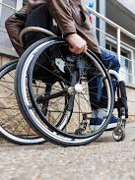
Physical/structural accessibility
Sidewalks and doorways that are too narrow for a wheelchair, scooter, or walker
Desks that are too high for a person using a wheelchair or other mobility device
Poor lighting that makes it difficult for a person with low vision to see
Doorknobs that are difficult to grasp
No ramps or elevators
Accessible Parking
Signage/Tactile Signage

Slide 19
Physical accessibility & title III
Americans with Disabilities Act Accessibility Guidelines
  U.S. Access Board – www.access-board.gov
  ADA Standards for Accessible Design - https://www.ada.gov/2010ADAstandards_index.htm
Notes:
Under Title III of the ADA, places of public accommodation have obligations to ensure physical accessibility for people with disabilities. For newly constructed facilities, and older facilities that have been undergone alterations, strict compliance with the Americans with Disabilities Act Accessibility Guidelines (ADAAG) is required. The ADAAG standards are highly specific design specifications to enable facilities to be readily accessible and usable by people with disabilities. Older buildings (those first occupied before January 26, 1993) covered by Title III of the ADA are subject to lower standards, though they are still very important.
These places of public accommodations, when it is readily achievable to do so and does not involve much difficulty or expense, must remove architectural barriers that are structural in nature. Architectural barriers are physical elements of a facility that impede access by people with disabilities. Depending on the financial resources of the private business and other factors, there are a number of modifications that may be readily achievable, including installing ramps, making curbs cuts in sidewalks or entrances, repositioning shelves, widening doorways, installing grab bars in toilet stalls, and other similar measures.

Slide 20
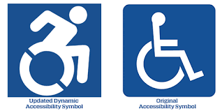
General guidelines for physical accessibility
Maintain in workable operating condition those features and equipment used by persons with disabilities
Provide signage at all inaccessible entrances directing people to the accessible entrance or accessible facility via the use of the international symbol for accessibility
Shall permit the use of wheelchairs and other mobility aids in pedestrian areas
Cannot ask a person using a wheelchair questions about the nature of or extent of their disability

Slide 21
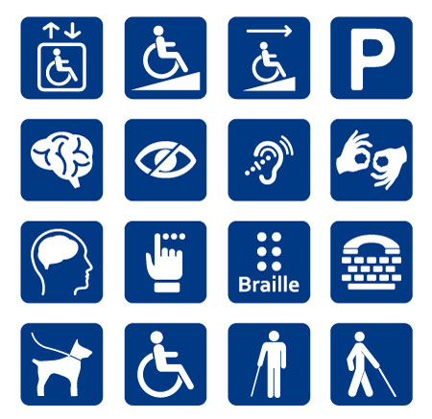
Programmatic accessibility
Modifying policies, practices, and procedures in order to provide an equal opportunity for a person with a disability to participate
A public entity’s services, programs, and activities, when viewed in their entirety, must be readily accessible to and usable by people with disabilities

Slide 22
Program accessibility examples
  Assistance filling out forms
  Explaining materials and/or procedures in basic language for universal accessibility
  Allowing a person with a disability to receive services over the phone if their disability prevents them from coming into the office
  Reassigning services to accessible locations
  Scheduling appointments to accommodate their schedule (i.e. medication, caregivers)
  Goes hand in hand with physical accessibility
  Using email, text, and chat
  Audio recordings for publications
  Accessible websites and online forms
  Relay Interpreting Services
  Large print

Slide 23
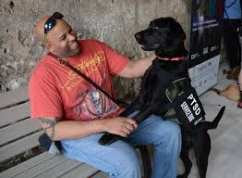
Service animals
March 15th, 2011 – Only dogs (and in some cases miniature horses) are recognized as service animals under Titles II and III under the ADA
A dog that is individually trained to do work or perform tasks for a person with a disability
Emotional support, therapy, and comfort animals are not covered under the ADA

Slide 24
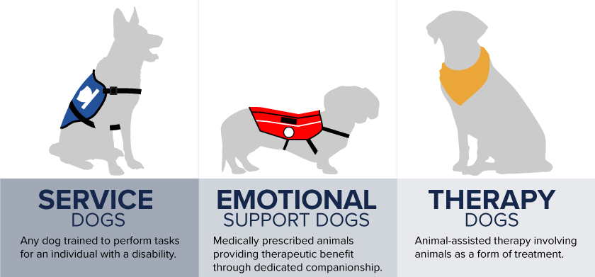

Slide 25
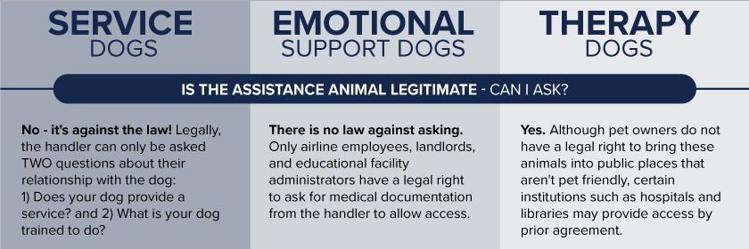
Questions about a service animal
Cannot require documentation or certification of special licensing
https://www.ada.gov/regs2010/service_animal_qa.html

Slide 26
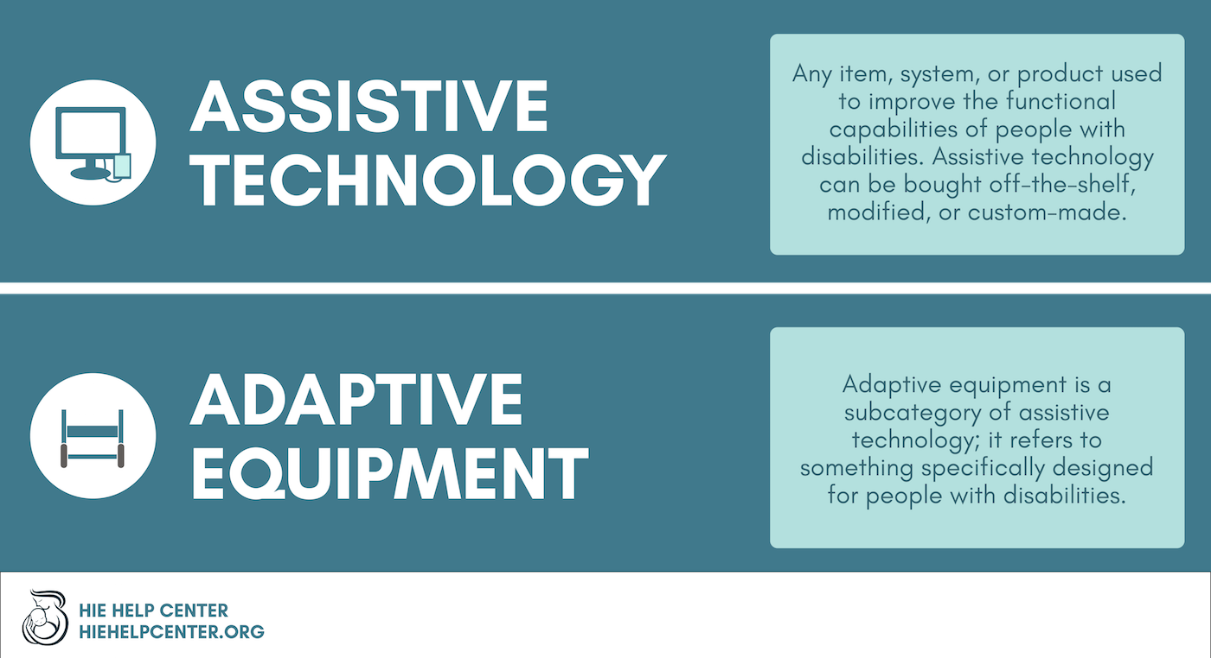

Slide 27

Effective communication
The ADA requires that all Title III entities provide or allow assistive technology to make sure that people with disabilities can communicate effectively
The goal is to ensure that communication with people with disabilities is as EFFECTIVE as the communication with people without disabilities

Slide 28
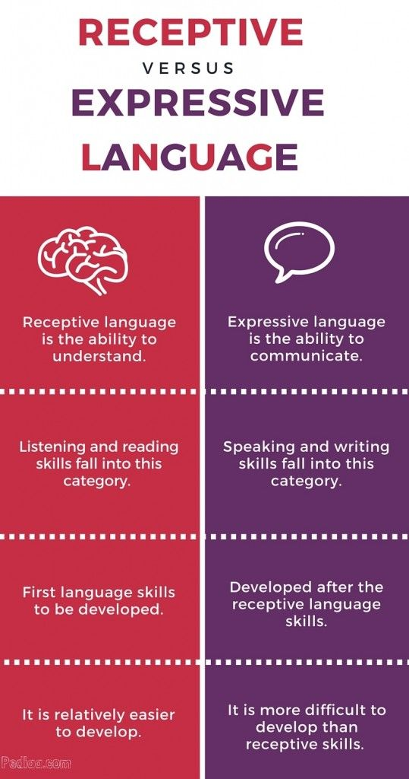
Receptive & expressive language

Slide 29
More on effective communication
Using audio format to ensure that a visually impaired or blind individual has access to the same information as a person without a visual disability
Alternate formats
Qualified Interpreters
Family and children as interpreters
Video Remote Interpreting (VRI)
Funding for effective communication
Understand that trauma affects our ability to communicate

Slide 30

Alternate formats for effective communication
Real-time computer aided transcription services
Telephone handset amplifiers
Telephones compatible with hearing aids
Open and Closed Captioning
Videotext displays
Audio recordings
Brailled materials
Large print materials
Social Stories

Slide 31
Attitudinal accessibility
Refusing to accept prejudice, myths, and stereotypes about people with disabilities and identifying and removing any negative attitudes about the capability of people with disabilities
The GREATEST obstacle to equitable access for persons with disabilities
Attitudinal barriers are, for the most part, invisible
Our field and those who work in it must be willing to admit when they don’t know
We must be willing to challenge our beliefs and perceptions
Rooted in ableism
Notes:
Prejudices and stereotypes about people living with disabilities have discouraged full integration into communities. If we wish to commit to providing inclusive and equitable services to ALL survivors, then we must learn to be attitudinally accessible. Attitudinal accessibility is defined as, “refusing to accept prejudice, myths and stereotypes about people with disabilities and identifying and removing any negative attitudes about the capability of people with disabilities.”7 These attitudes and behaviors rob survivors of dignity, autonomy, and independence.8 In order for providers to understand how to become more accessible to persons with disabilities, it is very important to understand why many survivors with disabilities may not report.

Slide 32

Attitudinal in-accessibility
Assuming that a person with a disability is inferior (What would this look like?)
Using ableist language
Stereotyping
“Inspiration Porn”
Making assumptions about a person’s capabilities based on their diagnosis
Rooted in misconceptions, ableism, and lack of understanding
Perpetuates violence, stigma, prejudice, and discrimination

Slide 33
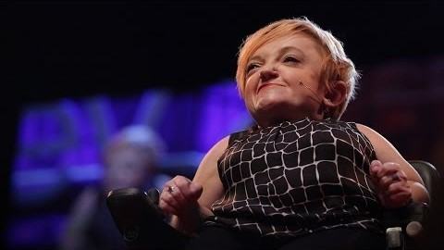

Slide 34
A Word about language
DO NOT
Cripple
Psycho
Mentally Retarded
“What’s Wrong with you?”
Handicapped
“In or bound to a wheelchair”
Physically Challenged
Abnormal/Invalid
DO
Person with a disability
Person with a mental health disability
Person diagnosed with…
Accessible parking spot
Learning disability/Cognitive disability
Uses a wheelchair

Slide 35
Other forms of accessibility
Media
Technology
Informational
Systemic/Policy
Economic
Social
Transportation
Medical
Notes:
Safety Planning – When conducting safety planning with a disabled survivor, we must consider all of the other ways they may be limited. Here are other forms of inaccessibility that survivors with disabilities face. The recommendations and plans we might make with a non-disabled survivor are going to be different than those with a disabled survivor. Consider the forms of accessibility (physical, programmatic, attitudinal) when safety planning and provided the survivor with resources. Are they accessible in any of the three formats?

Slide 36

Inaccessibility shapes services
Perpetuates harmful stereotypes
Propagates violence
Inhibits healing
Obstructs justice
Limits services
Segregates survivors
Harms people with disabilities
Preserves ableism
Continued erasure of disabled persons

Slide 37
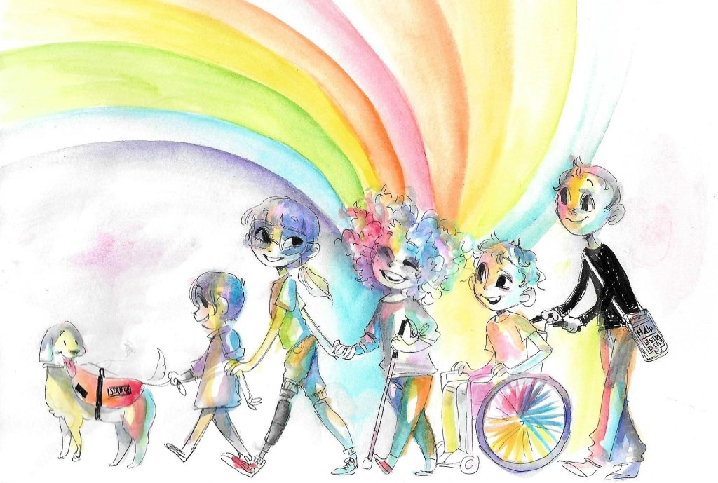
If you don’t remember anything else….
People with disabilities are first and foremost…PEOPLE!
Disability is a spectrum. What works for one person might not work for the next.
Flexibility is key!
Don’t build the box!
Healing, like disability, is a spectrum and will look different for each survivor

Slide 38
Rights for disabled survivors
No Exclusion or Discrimination
Communication Access
  Effective communication
  Access to interpreters
Programmatic Access
  Service animals
  Assistive/Adaptive Technology
Facility Access
Employment

Slide 39


Slide 40

24-Hour Hotlines &
Intake
Video phones/Relay services
Chat services
Inclusive language
Referring to therapists
When calls require more time
Disability services

Slide 41

Legal advocacy
Who is involved?
What are their roles?
How does the RCC fit within this collaboration?
Court accompaniment
Comfort bags
Communication devices
Notification of rights
Effective communication

Slide 42

Hospital/medical advocacy
Rights of a disabled survivor
Privacy
Guardianship
Communication techniques
Medical Model vs. Social Model

Slide 43

SAFETY PLANNING
Resources that are disability specific
Contacts for support system
If caregiver is abuser, who can provide care?
Social Stories
Practice and Role Play
Copies of medical bracelets, medications prescribed, names and contact information for physicians and support system, documentation of disability, documentation of social security/benefits, payee information, medical orders, service animal documentation, etc.
Food and water set aside for the service animal/support animal

Slide 44
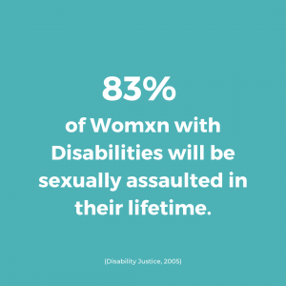
Community awareness & outreach
Deliberate Inclusivity
Effective communication
Non-ableist language
Accessibility statement
Staff education on accessibility
Website accessibility
Outreach guides
Notes:
**Something I noticed while looking for stock photos for this slide…there is a vast deficit of intimate partner violence images and disability. This indicates that acknowledgement of intimate partner violence in disability communities and subsequent representation of that epidemic is elusive.**

Slide 45

Coordination & collaboration
Who are the support people/support systems that may be linked to a survivor with a disability?
What are their roles?
Why is it important to know them?

Slide 46

Prevention education
Lack of prevention education for persons with disabilities
What does this look like?
Why is it important?
Partnerships with existing disability services
Nothing About Us, Without Us!
Resources

Slide 47

Professional counseling/therapy
Medical Model vs. Social Model
Ableism
Averting ableism
Resources

Slide 48
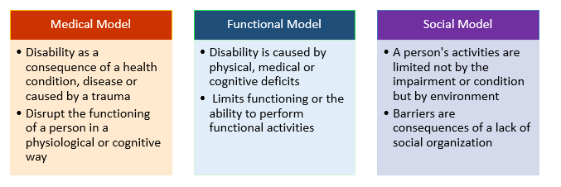

Slide 49

Support groups
Collaboration and partnerships
Accessibility of services

Slide 50
resources
ADA National Network - https://adata.org/
ADA National Network Regional Office - https://adata.org/find-your-region#region5
ADA Checklist for Existing Buildings - https://www.adachecklist.org/doc/fullchecklist/ada-checklist.pdf
United States Access Board - https://www.access-board.gov/
Americans with Disabilities Act - https://www.ada.gov/
National Association for the Deaf - https://www.nad.org/
National Organization on Disability – www.nod.org

Slide 51
resources
National Center on Disability and Journalism - https://ncdj.org/resources/organizations/
American Association of People with Disabilities - https://www.aapd.com/
Resources specifically for BIPOC with Disabilities
    https://oae.stanford.edu/students/advocacy-community/national-disability-organizations-and-resources

Slide 52
STATE resources
Adult Advocacy Centers
Disability Rights Ohio
OVWA – “Serving Survivors with Disabilities”
Ohio Department of Mental Health and Addiction Services
Ohio Department of Developmental Disabilities

