Slide 1
The Intersection of
Sexual Violence & Disability
Liz Poprocki, MA, RAAS, CA
Owner – Equitology Consulting, LLC

Slide 2
GOALS
Obtain foundational knowledge of epidemic of sexual violence against persons with disabilities
Challenge and address your own personal biases
Dissect the root causes of sexual violence against persons with disabilities
Identify sources of ableism and oppression
Leave with a new lens with which to practice equity and inclusivity

Slide 3
Content Warning
This presentation will include readings, media, and discussion about the sexual assault, physical violence, and identity-based discrimination of disabled persons. This content can be difficult to hear so you are encouraged to care for your safety and well-being.

Slide 4
SCOPE OF THE PROBLEM

Slide 5
JUST THE NUMBERS
70% of people with disabilities surveyed (+2,000) reported that they had been victims of abuse (The Disability & Abuse Project, 2013)
More than 63% of their family members said their loved one with a disability had been a victim of abuse (The Disability & Abuse Project, 2013)
In 2015, the rate of violent victimization (rape, robbery, aggravated assault) against persons with disabilities was more than 3 times higher than for persons without disabilities (Harrell, 2017)
During 2011-2015, persons with cognitive disabilities had the highest rates of total violent crime (57.9 per 1,000 people) (Harrell, 2017)
People with multiple disabilities were victims at a rate three times higher than people with a single disability (Harrell, 2017)
65% of rapes against persons with disabilities were committed against those with multiple disabilities – the HIGHEST percentage among all violent crime types (Harrell, 2017)

Slide 6

In 2018, NPR discovered unpublished data from the Bureau of Justice Statistics that showed that persons with disabilities are sexually assaulted at a rate 7 times that of neurotypical persons.

Slide 7
SEXUAL VIOLENCE AGAINST DISABLED MEN
The rate of violent victimization against males with disabilities was 31.8 per 1,000 persons compared to 14.1 per 1,000 for males without disabilities
The prevalence of lifetime sexual violence is 14% among disabled men compared to the 4% among men without disabilities
Men with cognitive disabilities might not know if they are victims of sexual violence because of the stigma surrounding all men, neurodiverse and neurotypical, and sexual violence

Slide 8
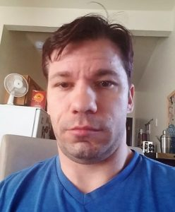
“For as long as I can remember society has had the idea that men do not show emotion. We are told to be strong, not to cry or share feelings. These ideas are communicated from an early age.
The expectations of manhood are very high and never include opening up about any type of abuse, especially sexual assault and violence perpetrated against them, as an adult or a child.
Men with disabilities face an even more difficult hurdle of not being believed or seen as credible when they do report because they have a disability, and can be even more difficult for those who are LGBTQ, who are at greater risk due to their sexual orientation.
Those in authority have looked the other way when we have disclosed. When disclosure happens we are not asked how we feel. For those that are not able to tell, they act out their fear in frustration and then are medicated and the abuse continues. Many of us do not believe there will be any consequences even if we do tell.
This is a deep-reaching issue that we must deal with to have a healthy, inclusive, and safer society. Every sexual assault survivor needs to know they matter, are respected, and can be safe.”
Chris Miller, Survivor

Slide 9
PROBLEMS WITH THIS DATA
Statistical Biases
Statistics based on the non-institutionalized population
Data on crimes committed against persons with disabilities is limited
This data is based on people 12 years old and older (Harrell, 2017)
It does not consider trans-men and trans-women with disabilities
Does not include mental illness
Lack of comprehensive data
  Not based on data from states
  Only based on those crimes reported
  Only based on those disabilities disclosed

Slide 10
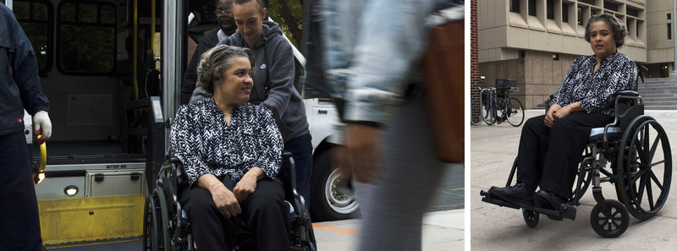
In Their Own Words
“I felt dirty. I just felt not clean. I blamed myself. And I felt powerless. I couldn’t even look in the mirror, because you see, all that comes back to you. It just does.”
Debbie Robinson, Survivor
Picture and quote from NPR exposé, “In Their Own Words: People with Intellectual Disabilities Talk About Rape

Slide 11
WHAT IS A DISABILITY?

Slide 12
DISABILITY POPULATION IN THE U.S.
40 million Americans live with a disability
14% of the population age 12 or older living outside of institutions have a disability (U.S. Census Bureau ACS, 2011-2015)
42% of the population with disabilities were age 65 or older (U.S. Census Bureau ACS, 2011-2015)

Slide 13
DISABILITY UNDER THE ADA
In the context of the ADA, “disability” is a legal term rather than a medical one. Because of this, the ADA’s definition is different than how disability is defined under other laws like Social Security Disability related laws.
The ADA is a federal act that requires your organizations to provide accommodations and non-discriminatory services hence why we are using this definition today – it directly impacts you!
The ADA defines a person with a disability as a person who has a physical or mental impairment that substantially limits one or more major life activity.
This includes people who have had a record of such an impairment even if they do not currently have a disability.
It also includes individuals who do not have a disability but are regarded as having a disability. (https://adata.org/faq/can-you-give-me-example-someone-who-regarded-having-disability)
Notes:
***Include notes from NOVA training re: vague and expansive definition of disability in the ADA***

Slide 14
TACTICS OF VICTIMIZATION

Slide 15
PHYSICAL ABUSE
Hitting
Kicked
Punched
Pinched
Tripped
Restraint
Isolation
Harming of service animal
Destroying assistive technology
Ignoring safety requirements
Using equipment to harm the person

Slide 16


MEDICAL OR PHYSICAL NEGLECT
Over or under medicating
Not enough food and/or drink
Withholding care
Unsafe environment
Withholding access to assistive technology, service animals, medical equipment
Not carrying out treatment plan
Using abuse as behavior management

Slide 17

EMOTIONAL ABUSE
Blaming
Shaming
Humiliating and Ridiculing
Intimidation
Coercion
Threatening
Using the person’s disability against them
Ignoring requests
Minimize, justify, and blame

Slide 18
THEFT
& FRAUD
Financial exploitation
Financial scams
Theft by guardians
Stealing survivor’s belongings
Selling survivor’s belongings
Identity theft
Social security theft
Limiting access to funds

Slide 19

SEXUAL ABUSE & ASSAULT
When speaking about sexual assault against persons with disabilities, the term “abuse” is used most often. Even in our language, we are not being equitable.
Penetration, touching, voyeurism, coercion, rape
Power and control
All of the other tactics of victimization are used to sexually assault a person with a disability and to keep them from reporting
Notes:
***Expand on why power and control is a different dynamic with caregivers and peers as perpetrators***

Slide 20
WHO IS OFFENDING?

Slide 21
“I took a liking to him. I spent the most time with him and taught him how to brush his teeth, tie his sneakers and even ride a bike. I would often take him for [shoulder] rides, at his request, and carry him around the residence.
I could have stayed in that house for years and abused him every day without anybody noticing at all. It was a predator’s dream.”
Stephen DeProspero
Currently serving 40 years in prison for filming himself sexually assaulting a disabled 10 year old boy he cared for at a state institution in New York

Slide 22
OFFENDERS
40% committed by persons the victims knew well or who were casual acquaintances
  Transportation
  Caregivers
  Service Providers
30% committed by strangers
15% committed by significant others
10% committed by family members
5% unknown
  (U.S. Dept. of Justice, 2016)

Slide 23
Perpetrators against persons with disabilities do so from the framework that the individual is the problem.
Their disability makes them vulnerable.
This way of thinking is victim-blaming, ableist, and holds the victim responsible for their own victimization.

Slide 24
WHY VICTIMIZE A DISABLED PERSON?

Slide 25
POLLING
Participants will use Poll Everywhere to enter their answers to “Why victimize a disabled person?” This question aims to put the participant in the shoes of the perpetrator.

Slide 26
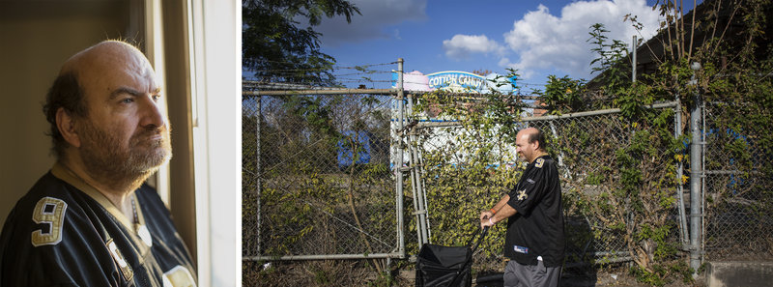
In Their Own Words
“I don’t want to say easy target, but it is an easy target, because people try to work so hard to try to find friends and try to fit in our community.”
James Meadours, Survivor and Activist
Picture and quote from NPR exposé, “In Their Own Words: People With Intellectual Disabilities Talk About Rape

Slide 27
WHAT ARE THE BARRIERS TO REPORTING?

Slide 28
POLLING
Participants will use Poll Everywhere to answer the question, “What are the barriers to reporting?” This question aims to place the participant in the shoes of the victim with the disability.

Slide 29
BARRIERS TO REPORTING
Lack of access to assistive technology
Lack of universal design
Caregivers and family members
Physical, Attitudinal, and Programmatic inaccessibility to services
Limited knowledge of supports or advocacy services
Inaccessible systems
Coercion to not disclose or seek help
Service provider biases/survivor’s biases
BARRIERS COME FROM ABLEISM

Slide 30
PERCEIVED VULNERABILITIES

Slide 31
WHAT ARE “PERCEIVED VULNERABILITIES”?
Their disability
Taught to obey
Communication limitations
Reliance on caregivers
Isolation in homes and residential facilities
Seen as not credible or reliable
No sex education or healthy relationships
Perceived vulnerabilities are taught to the individual with the disability. They are vulnerabilities learned from a society that is inaccessible and unwilling to meet their needs. They are a form of ableism.

Slide 32
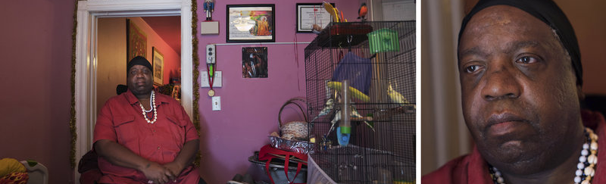
IN THEIR OWN WORDS
“We are taught to trust grown-ups more than anyone else would be. Because when you have a disability, people are always telling you, ‘Do as that person says’, ‘Do as this person says.’”
Thomas Mangrum, Survivor
Picture and quote from NPR exposé, “In Their Own Words: People with Intellectual Disabilities Talk About Rape”

Slide 33

10 Minute Break

Slide 34
WHY IS THIS HAPPENING?

Slide 35
HISTORICAL & SOCIETAL OPPRESSION
Greek and Roman empires – Obsessed with beauty. Believed beauty and intelligence were intertwined. Believed successful communication was the key to learning. No word existed for “disabled”. Having a disability meant god hated you. Disabled children were killed or left for dead.
Middle Ages – People with disabilities were outcasts, considered evil and cursed by God. Institutions were first developed and the conditions were less than humane.
Renaissance – Institutionalization continued. People with disabilities were used as court jesters and entertainment. The first psychiatric hospital was built.
1700s – Continued institutionalization, eugenics, test subjects, segregation, homicides, and sent to be with the circus.
1800s – Poorhouses built to remove persons with disabilities from the streets. Eugenics continued.
1900s – Continued to be test subjects, institutionalized and segregated. Persons with disabilities were not allowed to enter the United States. Sent to be with the circus. Continued eugenics.

Slide 36
ABLEISM – WHAT IS IT?
Ableism is the discrimination of and social prejudice against people with disabilities based on the belief that neurotypical abilities are superior.
Ableism classifies an entire group of people as “less than”
Ableist views and beliefs are at the core of why persons with disabilities continue to be sexually assaulted.
Internalized Ableism – Beliefs that being able-bodied or able-minded is preferable. It can be weaponized toward yourself or toward other disabled people through modifying, shaming, or policing your own behaviors and actions to appear more “abled”.

Slide 37
“A system that places value on people’s bodies and minds based on socially constructed ideas of normalcy, intelligence, and excellence. These constructed ideas are rooted in anti-Blackness, eugenics and capitalism. This form of systemic oppression leads to people and society determining who is valuable or worthy based on people’s appearance and/or their ability to satisfactorily produce, excel, and behave.”
– A working definition by Talila “TL” Lewis

Slide 38
ABLEIST LANGUAGE
“That’s so lame.”
“You’re retarded.”
“That guy is crazy.”
“You’re so bipolar today.”
“Are you off your meds?”
“It’s like the blind leading the blind.”
“My ideas fell on deaf ears.”
“She’s a psycho!”
“I’m super OCD about how I clean.”
“Oh my God that totally gave me a panic attack!”
“Can I pray for you?”
“I don’t even think of you as disabled.”

Slide 39
ABLEISM IN DAILY LIFE (to name a few)
Physical barriers such as lack of ramps, elevators, no sidewalks, no push-buttons for doors, lack of accessible transit
Poorly designed rooms, narrow doorways, door knobs that are hard to open
Story lines that include disabled characters written to be angry, difficult, or used for “inspiration porn”
Not disclosing a disability for fear of not being hired
Talking to a person with a disability like a child
Erasure of disability rights history or disability pride movements
Assuming people have to have a visible disability to be disabled
Restraint and seclusion against people with disabilities
Questioning if someone is ‘actually’ disabled or ‘how much’ are they disabled
Lack of accessible housing
Marriage inequality (loss of benefits if they marry)
Financial constraints (will lose their much needed benefits if they work)
Unequal pay

Slide 40
ABLEISM IN THE ANTI-SEXUAL VIOLENCE MOVEMENT
Inaccessible advocacy organizations (physical, attitudinal, and programmatic)
Inaccessible hospital examinations and advocacy services
Service providers don’t understand the Americans with Disabilities Act
Persons with disabilities aren’t being taught about sexual health and healthy relationships
Minimizing and ignoring the impairment and how traumas affect disabilities
The medical model is used the most in addressing sexual violence against persons with disabilities
Harmful biases and beliefs from service providers and allied professionals
Ableism dictates what kinds of services survivors with disabilities can receive
Harmful and destructive language
Not acknowledging the survivor’s cultural differences as a disabled person
Survivor rights not being upheld or exercised because of ableism
Lack of training and education around safety planning
Trusting service providers and caregivers too much
Not listening to the person living with the disability and instead believing the neurotypical appearing person

Slide 41
SEXUAL ABLEISM
A denial of the ability to be sexual.
Sexual ableism defines how bodies experience oversight and regulation of sexual and reproductive behaviors.
Supports the notion that persons with disabilities are not fit to marry, have children, or enjoy sex therefore they are not educated on how to have safe consensual sex and healthy relationships
Support the idea that persons with disabilities, specifically intellectual disabilities, are not sexual beings
Prevention specialists need to be concerned about sexual ableism

Slide 42
VIOLENT ABLEISM
Violence is a mechanism by which individuals assert ableism
Violent ableism encompasses deprivation of health through personal violence (direct violence) and social injustice (structural violence). (“Violent Ableism: A Structural Epidemic”, 2019)
Broad assumptions about persons with disabilities dehumanize them and therefore increase their vulnerability to violence
Structural violence breeds violent ableism through personal and direct violence like sexual assault.

Slide 43
ABLEISM AND SEXUAL VIOLENCE
Ableism is a deep-rooted belief that persons with disabilities are far less important than neurotypical people.
Ableism seeks to continuously keep disabled persons disenfranchised and suffering.
Offenders use the tactics of power and control influenced by ableism to rape persons with disabilities
Our advocacy systems continue to utilize ableist views, beliefs, programming and services which stagnates the anti-sexual violence movement
Barriers and perceived vulnerabilities contribute to violent ableism.

Slide 44
POLLING
Participants will be using Poll Everywhere to anonymously share their experiences with ableism.
Participants will be prompted to share how they have participated in ableism, how their organization participates in ableism, and how others have experienced their ableism.

Slide 45

Ableism set the stage for:
Queer and trans people to be institutionalized as mentally disabled, mentally ill, sexually deviant, and “unfit”
Communities of color to be understood as less capable, smart or intelligent, therefore a “natural” fit for slave labor
Women’s bodies to produce children when, where, and how men needed them
People with disabilities to be seen as “disposable” in a capitalist and exploitive culture because we are not seen as “productive”
Immigrants to be thought of as a “disease” that we must “cure” because it is “weakening” our country
Violence, cycles of poverty, lack of resources, and war to be used as systemic tools to construct disability in communities and entire countries By Mia Mingus

Slide 46
WHERE DO WE GO FROM HERE?

Slide 47
TIPS FOR COMBATING ABLEISM
Believe people when they disclose a disability
Listen to people when they request an accommodation
Don’t assume you know what someone needs
Don’t speak on behalf of someone with a disability unless asked to
Talk about disabilities
Call in and call out ableism
Incorporate anti-ableism and accessibility into your awareness, programs, and organization
Make sure people with disabilities are at the table when decisions about them are being made
www.accessliving.org/newsroom/blog/ableism-101/

Slide 48
HOW TO APPLY THIS INFORMATION
In the next module, we will be discussing how to serve survivors of sexual violence with disabilities. Understanding ableism is a key component to being able to competently serve these survivors so that your services are equitable and accessible.
In the third and final module, we will be discussing how your organization can become more accessible in serving survivors with disabilities. The concepts learned today will influence your ability to competently design and implement accessible and equitable services for survivors with disabilities that combat ableism.

Slide 49
Liz Poprocki, MA, RAAS, CA
Owner
Equitology Consulting, LLC
equitologyconsulting@gmail.com

